Slide 1
2-7 Input/Output
Although our programs have implicitly shown how to print messages, we have not formally discussed how we use C facilities to input and output data. We devote two chapters, Chapter 7 and 13, to fully explain the C input/output facilities and how to use them. In this section, we describe simple input and output formatting.
Topics discussed in this section:
Streams
Formatting Input/Output
Computer Science: A Structured Programming Approach Using C

Slide 2
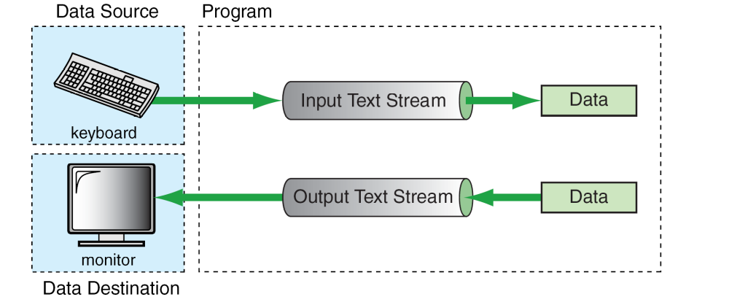
FIGURE 2-15 Stream Physical Devices
Computer Science: A Structured Programming Approach Using C

Slide 3
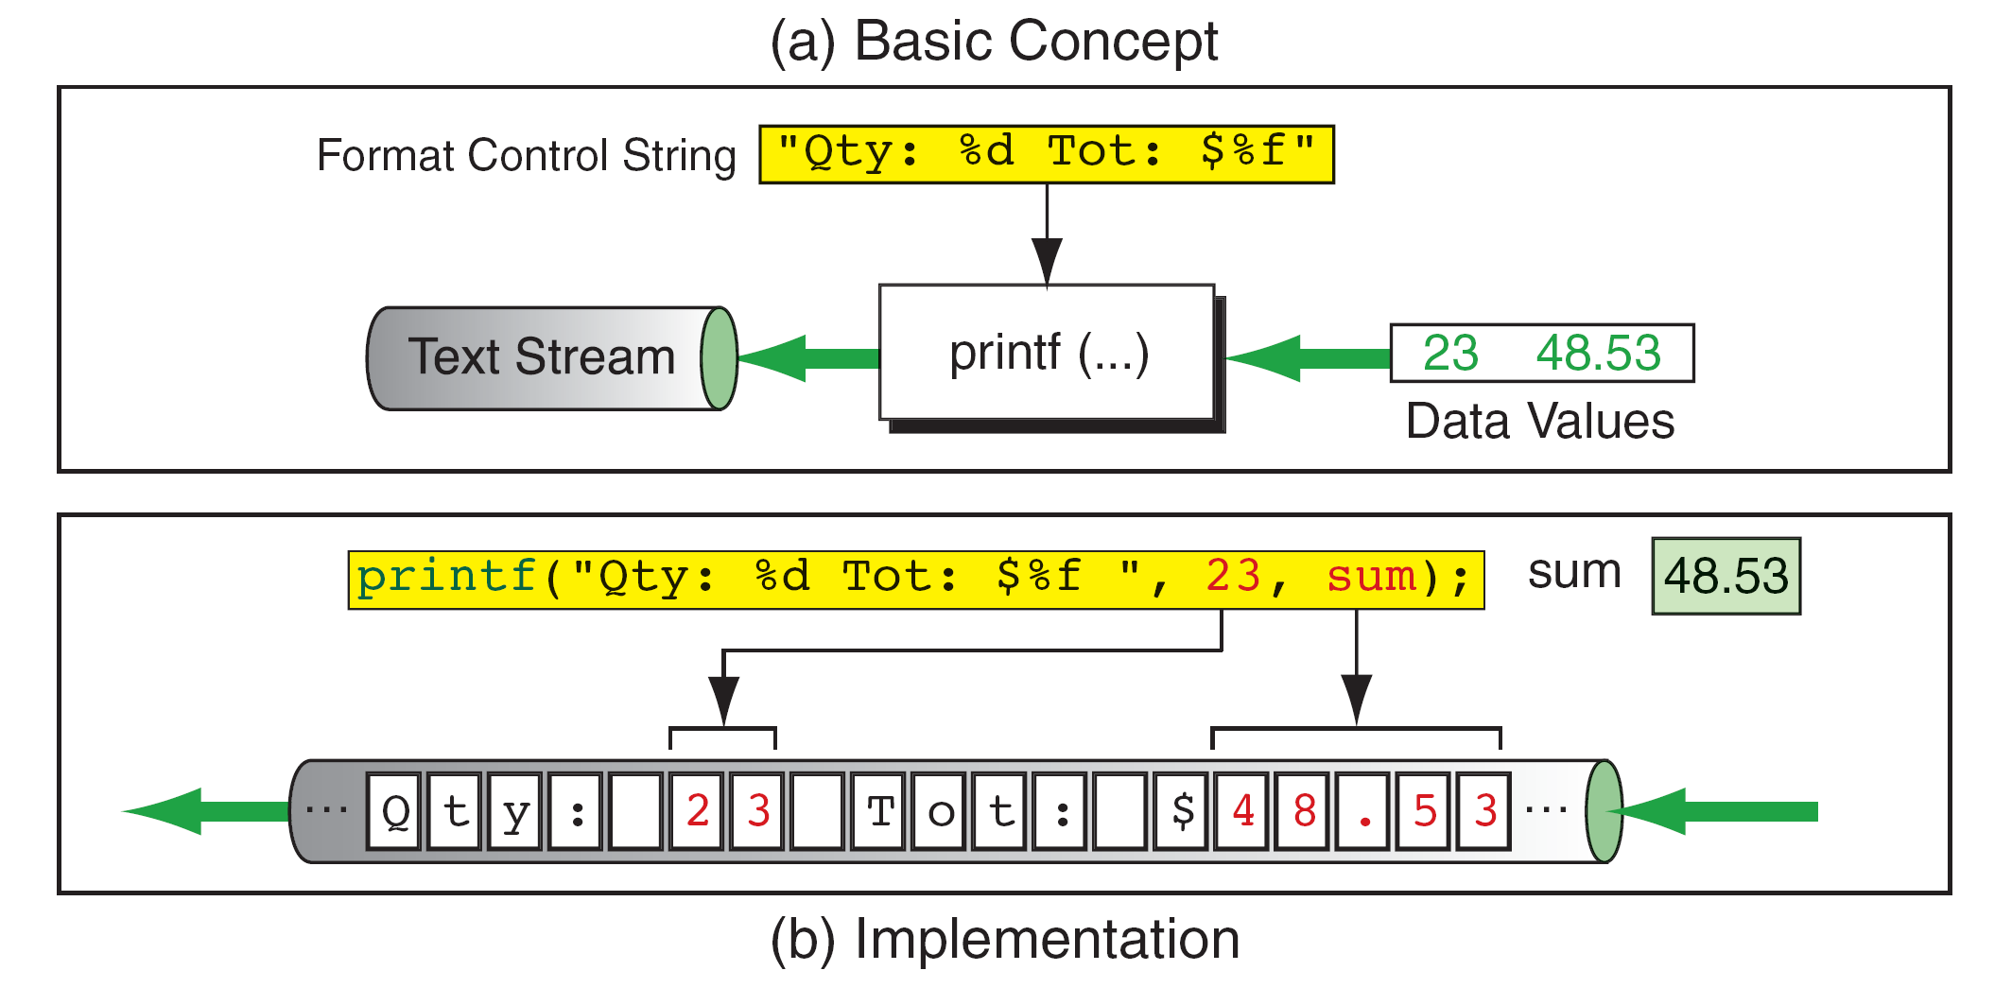
FIGURE 2-17 Output Stream Formatting Example
Computer Science: A Structured Programming Approach Using C

Slide 4
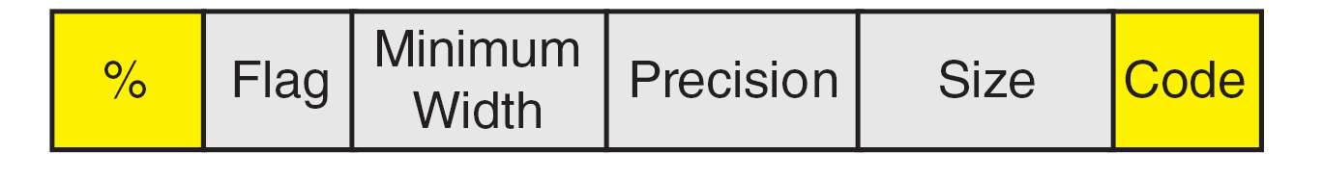
FIGURE 2-18 Conversion Specification
Computer Science: A Structured Programming Approach Using C
Notes:
Width: prints at least that many characters, pads if needed; if longer than width then prints the whole thing; size is for longs, etc.

Slide 5
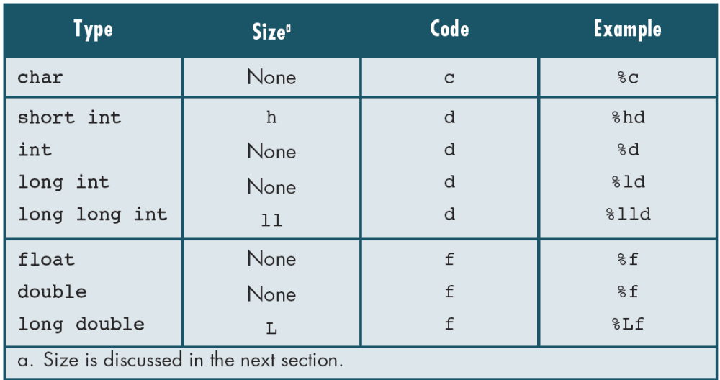
Table 2-10
Format Codes for Output
Computer Science: A Structured Programming Approach Using C

Slide 6
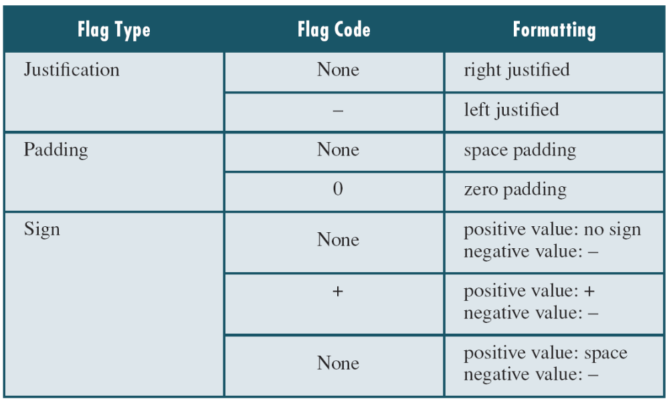
Table 2-11
Flag Formatting Options
Computer Science: A Structured Programming Approach Using C

Slide 7
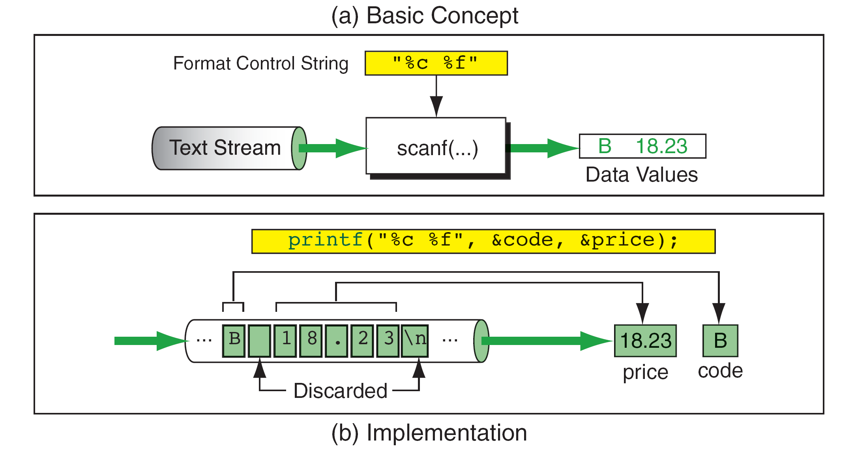
scanf
FIGURE 2-20 Input Stream Formatting Example
Computer Science: A Structured Programming Approach Using C
Notes:
SHOULD be SCANF

Slide 8
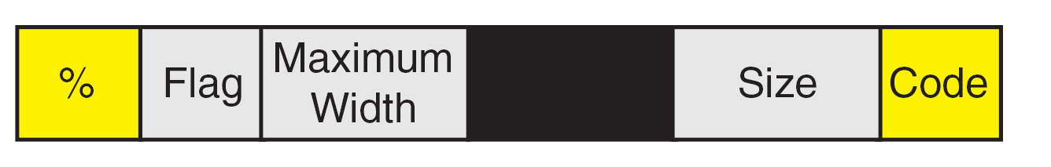
FIGURE 2-21 Conversion Specification
Computer Science: A Structured Programming Approach Using C
Notes:
For Scanf … Flag: * means don’t store input value; max width is max number of symbols to be read

Slide 9
Note
scanf requires variable addresses in the address list.
Computer Science: A Structured Programming Approach Using C

Slide 10
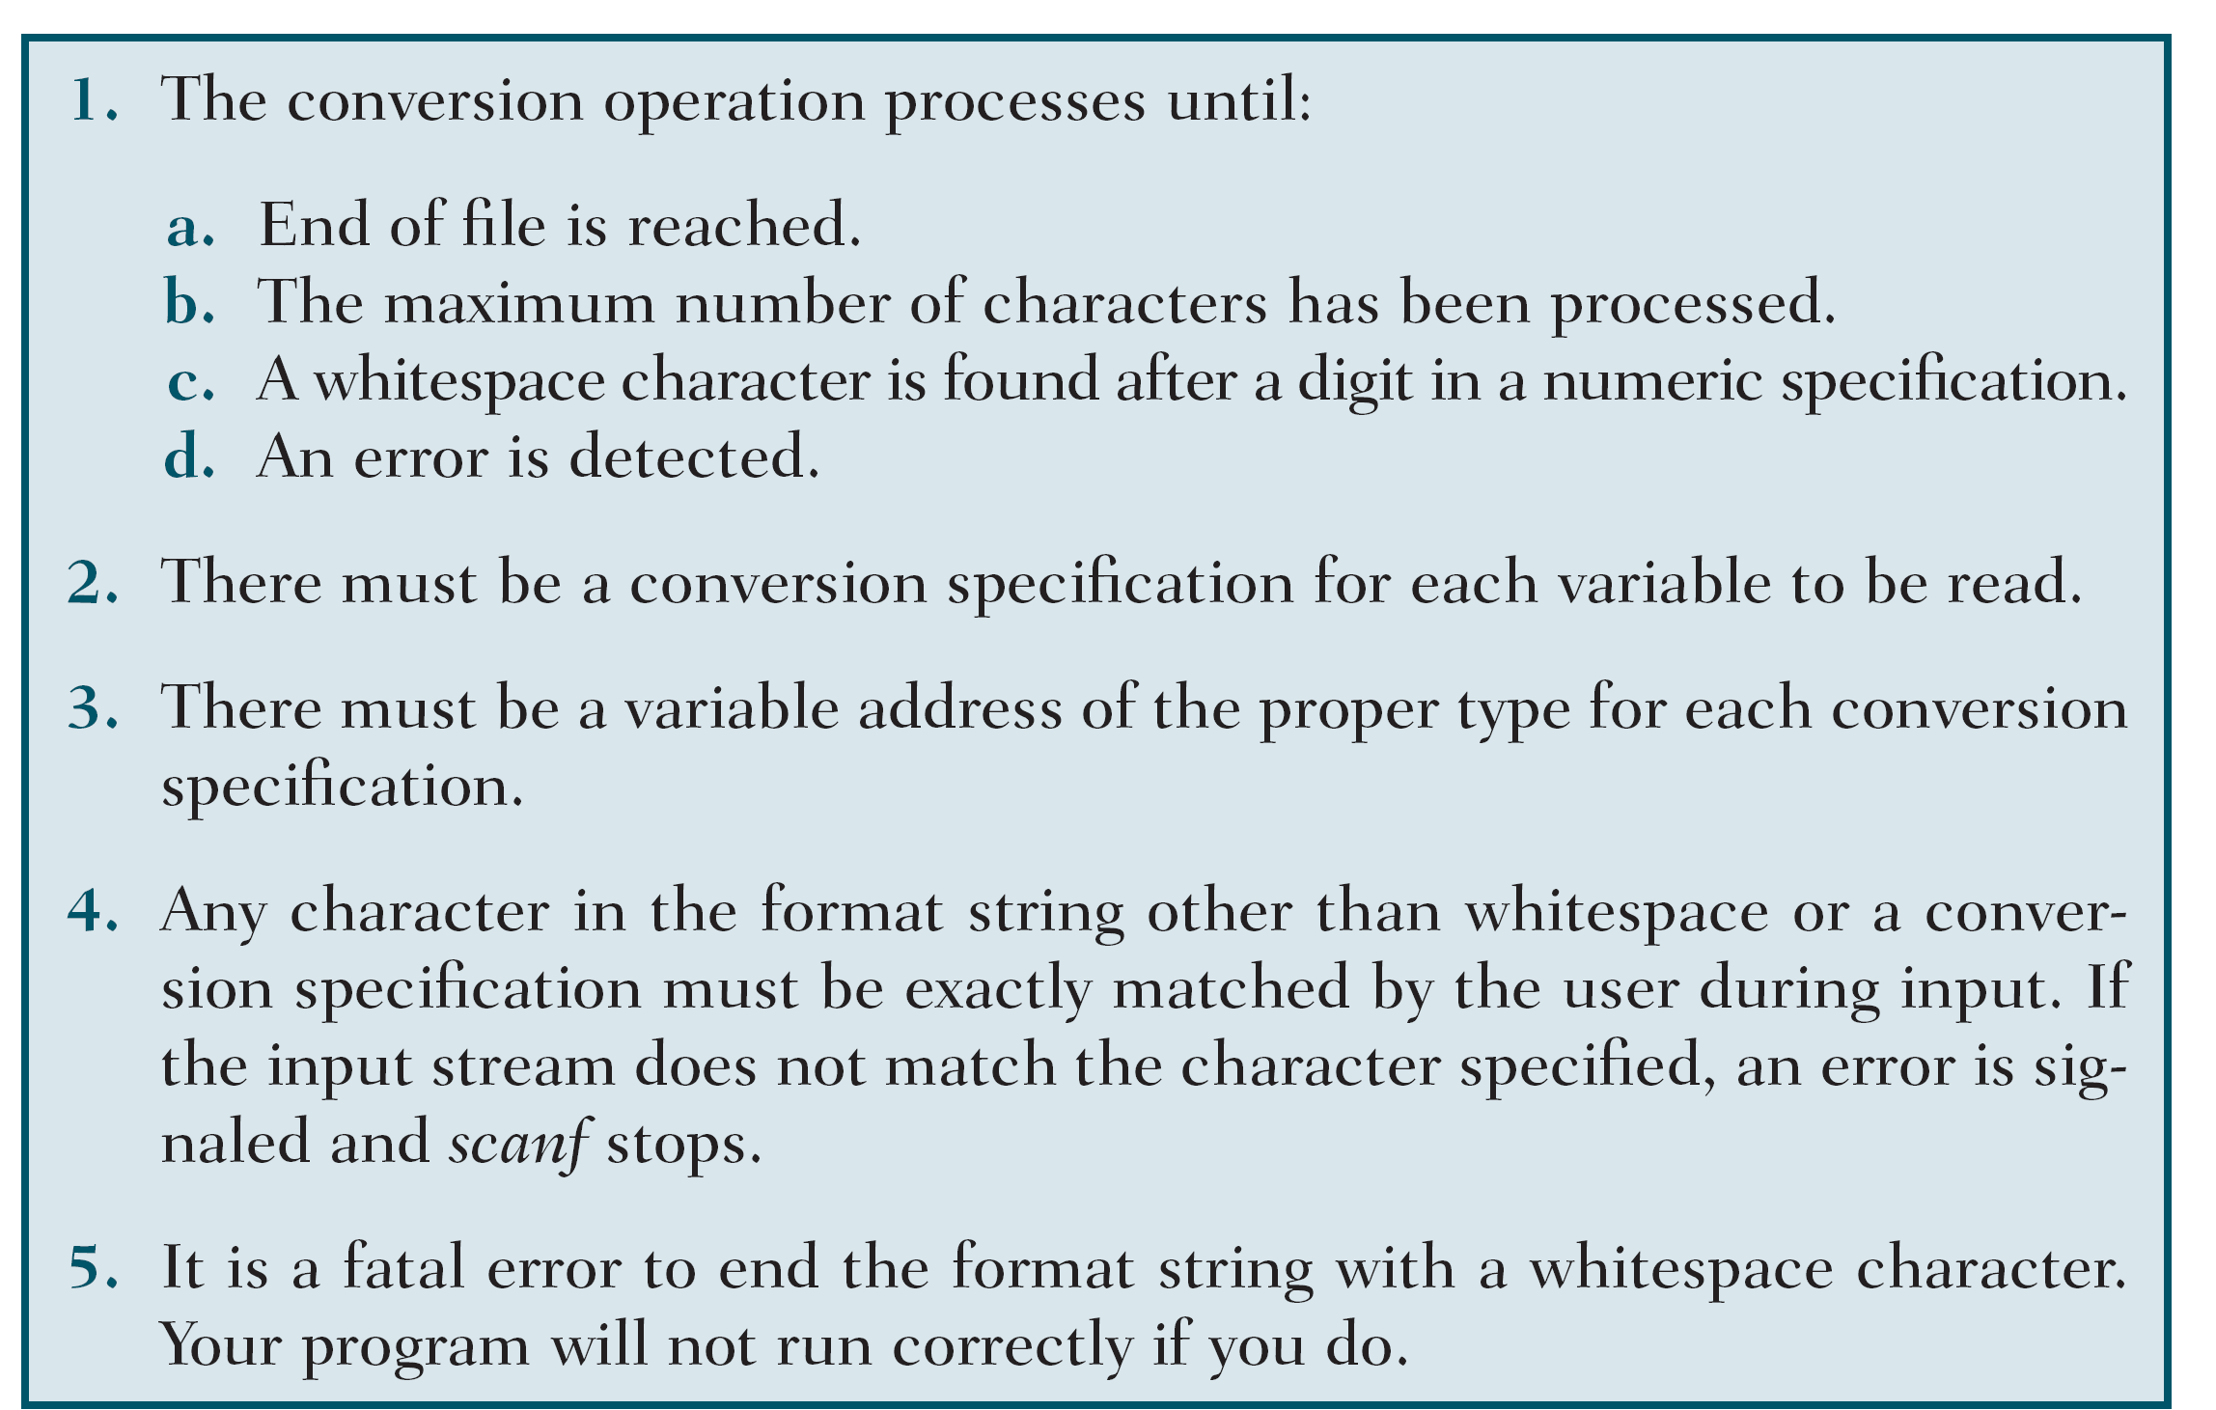
Table 2-12
scanf Rules
Computer Science: A Structured Programming Approach Using C

Slide 11
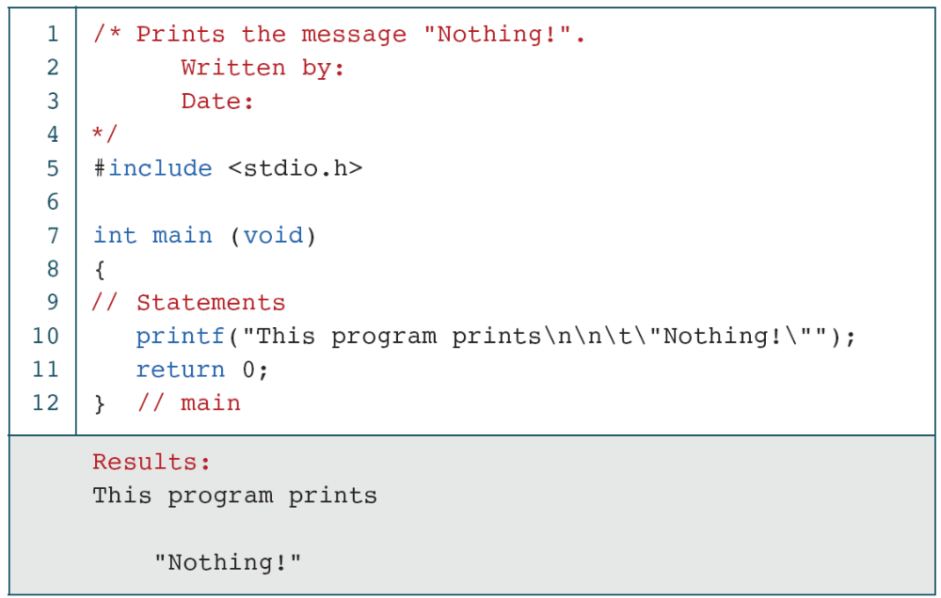
PROGRAM 2-4
A Program That Prints “Nothing!”
Computer Science: A Structured Programming Approach Using C

Slide 12
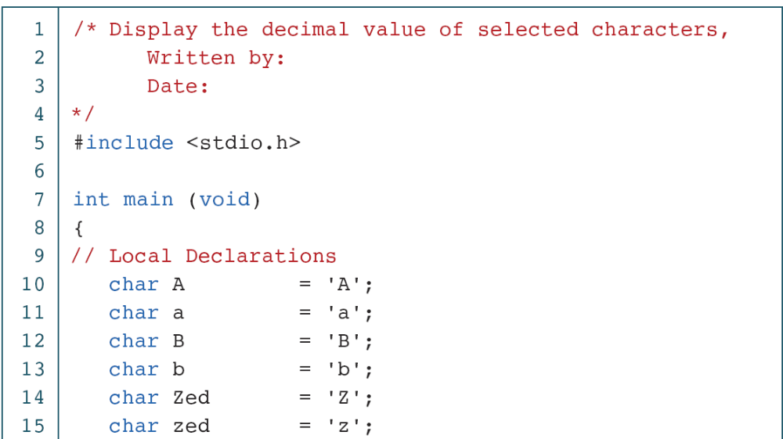
PROGRAM 2-6
Print Value of Selected Characters
Computer Science: A Structured Programming Approach Using C

Slide 13
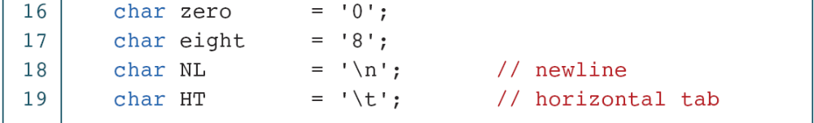
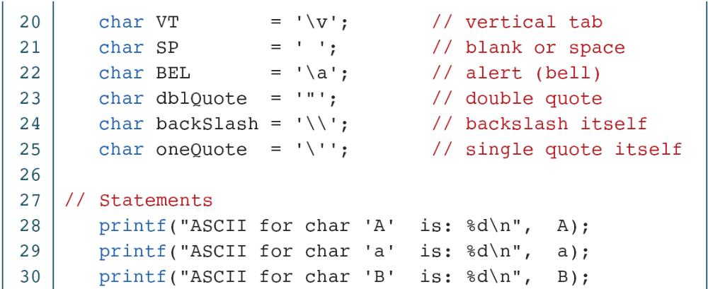
PROGRAM 2-6
Print Value of Selected Characters (continued)
Computer Science: A Structured Programming Approach Using C

Slide 14
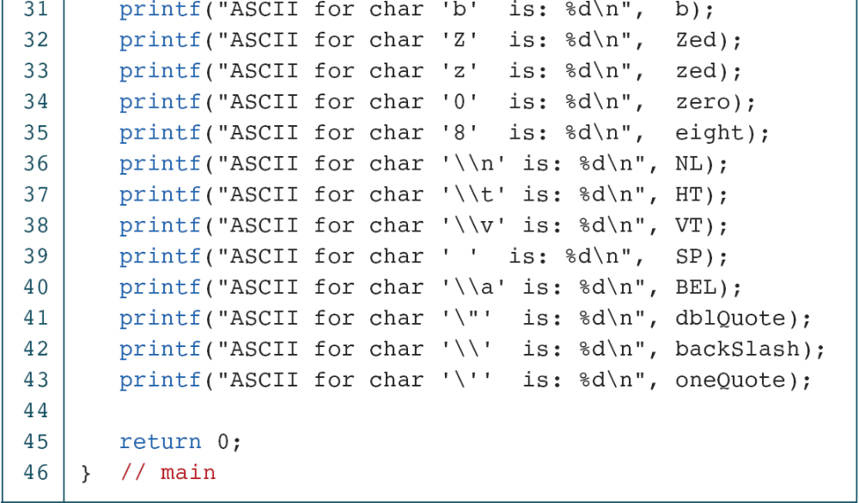
PROGRAM 2-6
Print Value of Selected Characters (continued)
Computer Science: A Structured Programming Approach Using C

Slide 15
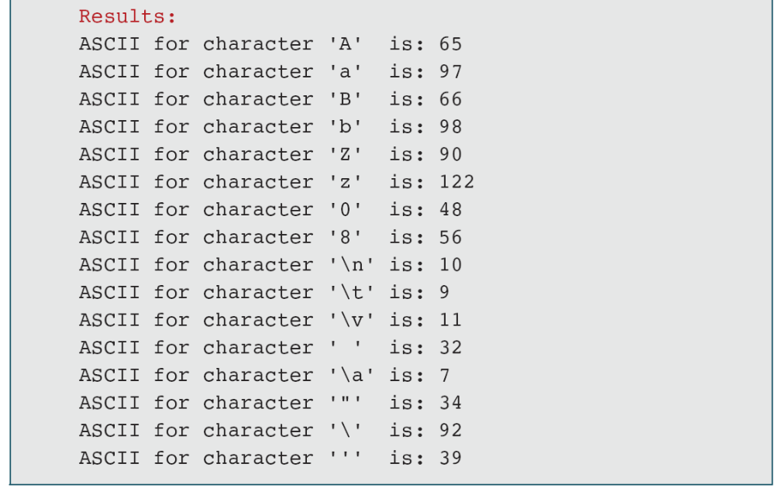
PROGRAM 2-6
Print Value of Selected Characters (continued)
Computer Science: A Structured Programming Approach Using C

Slide 16
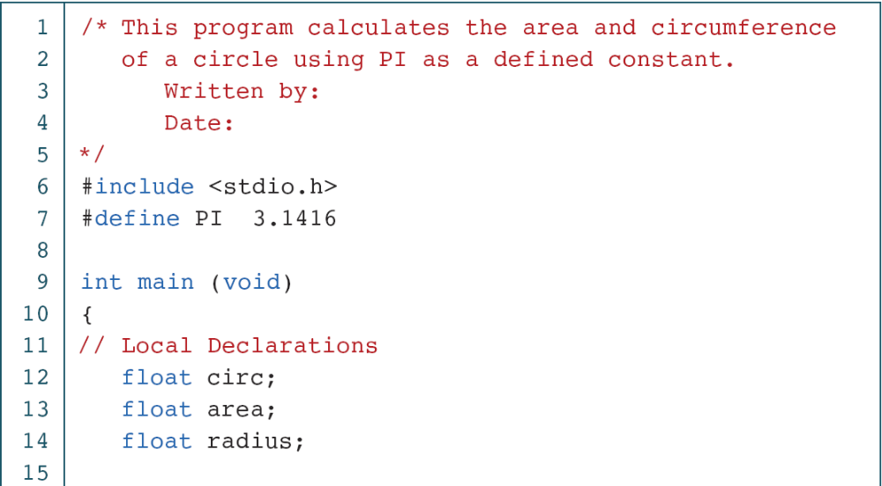
PROGRAM 2-7
Calculate a Circle’s Area and Circumference
Computer Science: A Structured Programming Approach Using C

Slide 17
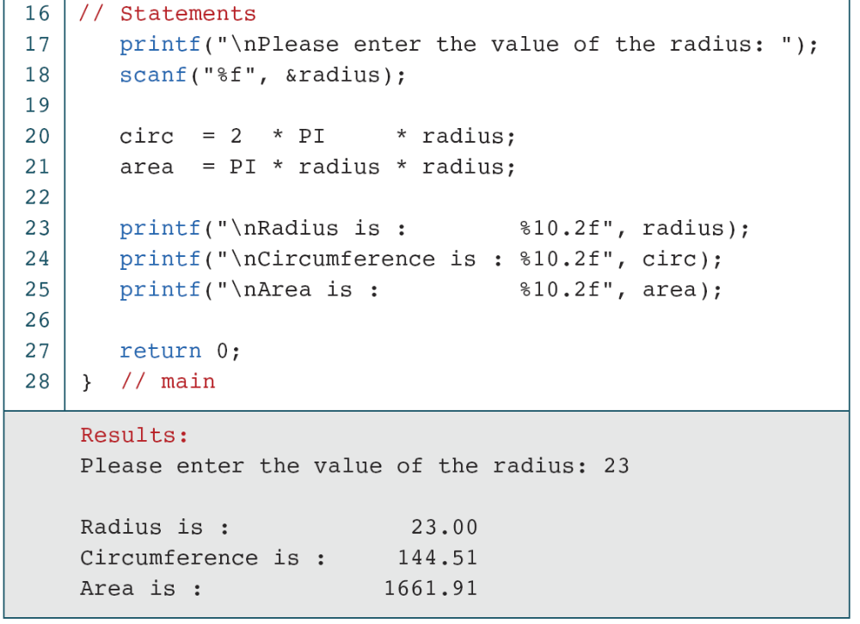
PROGRAM 2-7
Calculate a Circle’s Area and Circumference (continued)
Computer Science: A Structured Programming Approach Using C

Slide 18
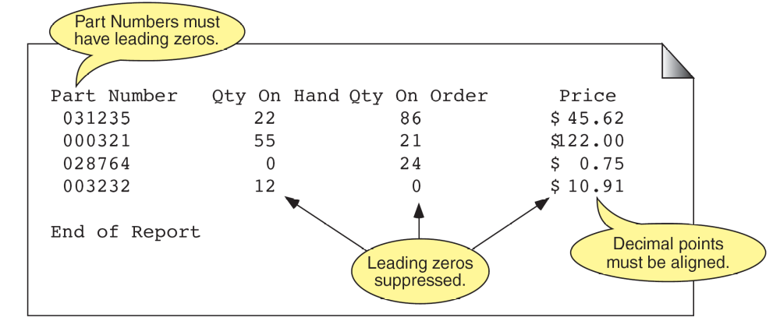
FIGURE 2-22 Output Specifications for Inventory Report
Computer Science: A Structured Programming Approach Using C

Slide 19
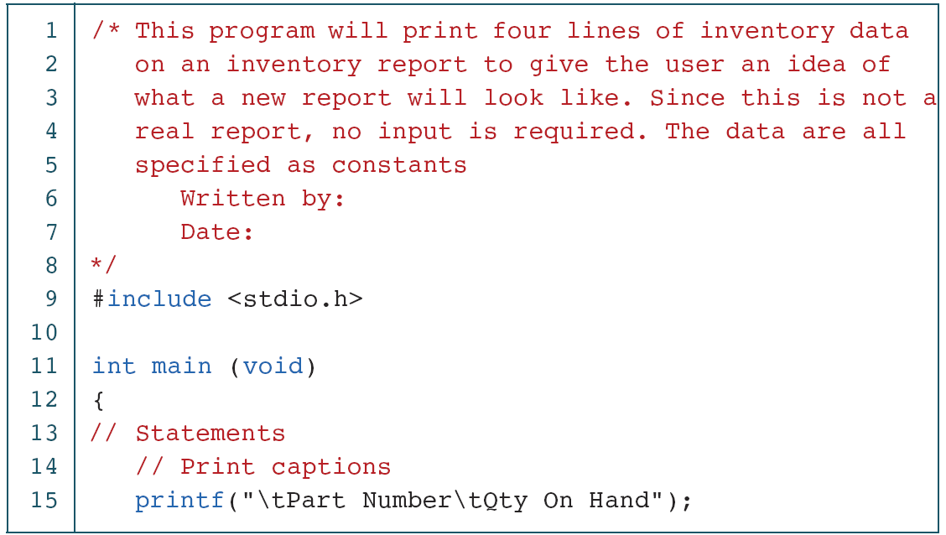
PROGRAM 2-8
A Sample Inventory Report
Computer Science: A Structured Programming Approach Using C

Slide 20
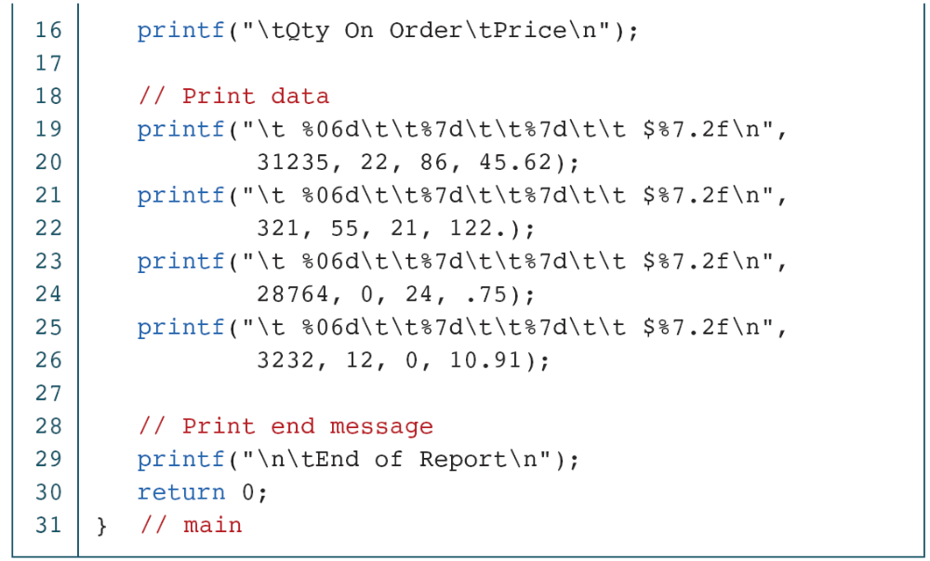
PROGRAM 2-8
A Sample Inventory Report (continued)
Computer Science: A Structured Programming Approach Using C
Notes:
0 flag means pad with 0’s

Slide 21
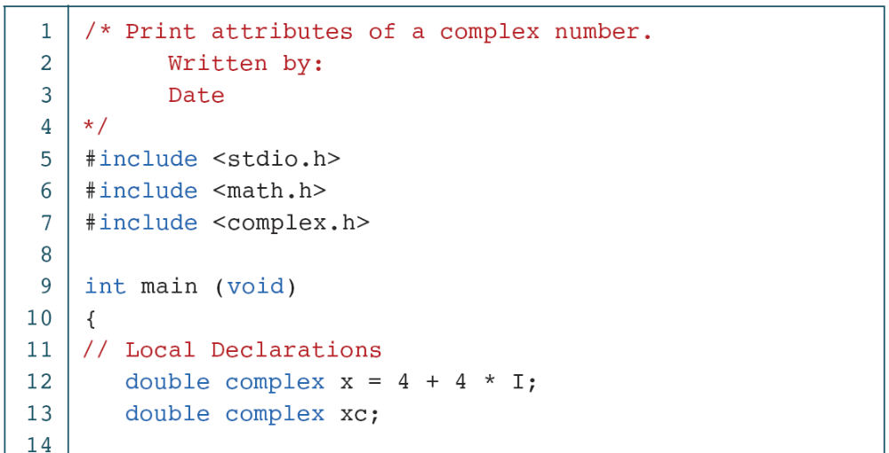
PROGRAM 2-9
Print Complex Number Attributes
Computer Science: A Structured Programming Approach Using C

Slide 22
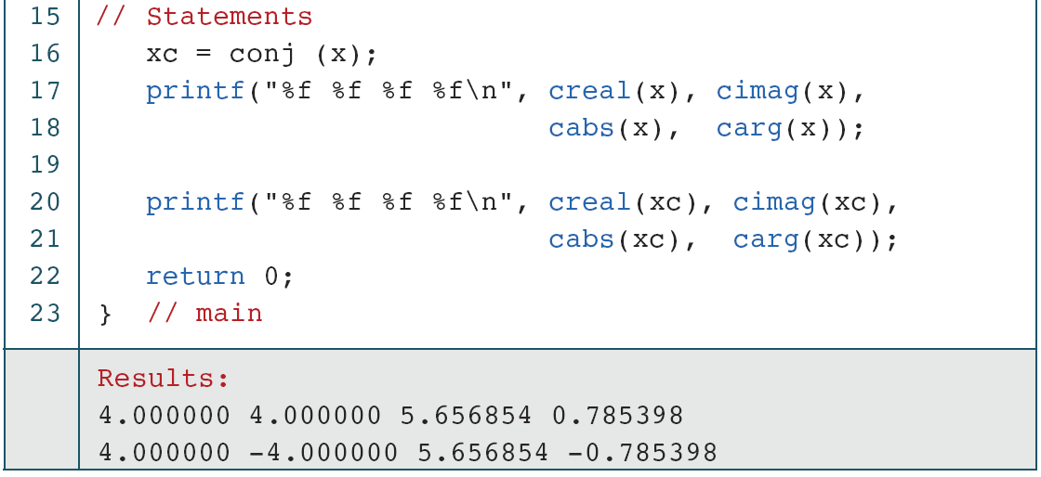
PROGRAM 2-9
Print Complex Number Attributes (continued)
Computer Science: A Structured Programming Approach Using C

Slide 23
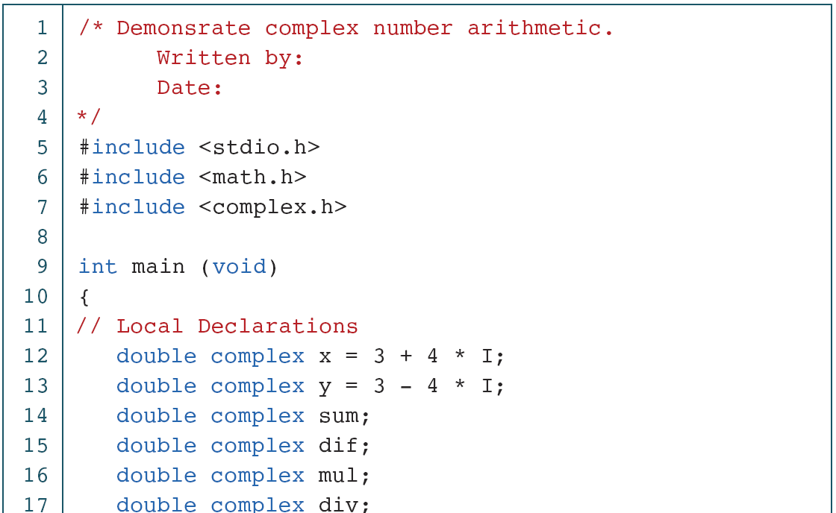
PROGRAM 2-10
Complex Number Arithmetic
Computer Science: A Structured Programming Approach Using C

Slide 24
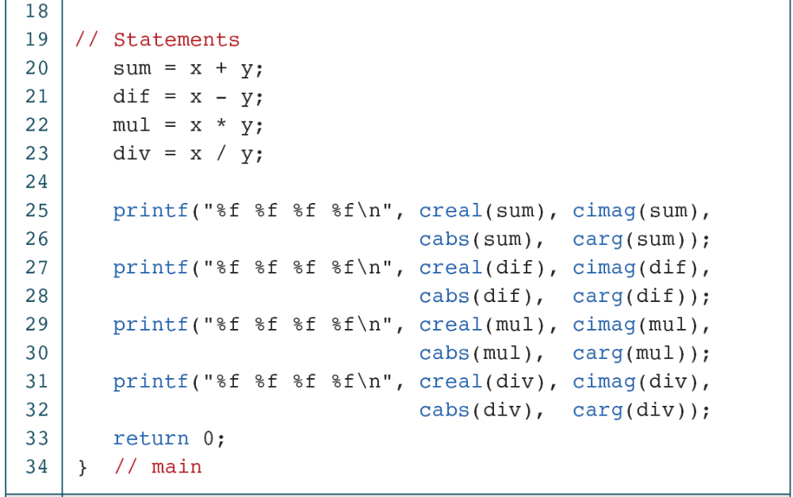
PROGRAM 2-10
Complex Number Arithmetic (continued)
Computer Science: A Structured Programming Approach Using C

Slide 25
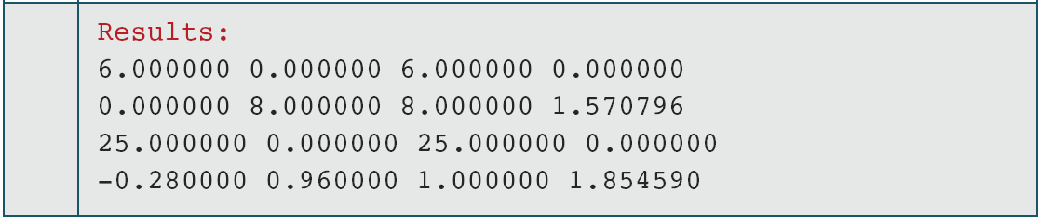
PROGRAM 2-10
Complex Number Arithmetic (continued)
Computer Science: A Structured Programming Approach Using C

